Slide 1

SIDDAGANGA INSTITUTE OF TECHNOLOGY, TUMKUR
Department of Information Science and Engineering
Major Project Final Review Presentation on
Geolocational Clustering for Personalized Student Accommodation
By:
Mohammad Saif Ul Islam 1SI21IS026
Akash V 1SI21IS061
Nishanka Nayak K 1SI21IS063
Ajay Singh Tomar 1SI21IS066
Under the guidance of
Dr R Aparna
Head of Department,
Dept. of ISE, SIT, Tumakuru

Slide 2
Outline
Problem Statement
Problem Statement
Introduction
Objectives
Literature Survey
Proposed Work
System Architecture
Methodology
Work Flow
Requirements
Results & Analysis
Analysis
Applications
Conclusion
References

Slide 3
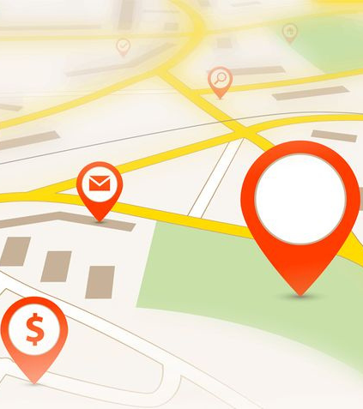

Problem Statement
Students from far away places struggle to find accommodation that matches their geographic preferences which leads to inconvenient living situations.
Thus, there is a need for a smarter, digital approach to match students with living spaces based on location-related factors like proximity to campus and access to amenities like restaurants, gyms, groceries, etc.

Slide 4
Introduction
Students often struggle to find housing close to their college with convenient access to amenities like restaurants, gyms, groceries, etc.
This project aims to help students find suitable accommodation using location-based clustering.
This tool will simplify the search process, making it easier for the students to find accommodations that match their preferences.
This approach will save students time and assist them in choosing better places to live.

Slide 5
Project Objectives
To provide personalized accommodation information for the students based on their preferences such as Gyms, Restaurants, Groceries, Hospitals etc.
To analyze the performance with different Machine Learning Algorithms like K-Means, Gaussian mixture model, Mean Shift.
Determine accommodation for multiple major cities in different states of India.
To develop a User friendly interface.

Slide 6
Literature Survey
Sl.No | Paper | Methodology | Outcomes
[1] | Exploratory Analysis of Geolocational Data Year: February 2023 Rushabh Marathe, Adarsh Jadhav | K-Means clustering groups accommodations using geo-data from sources like ‘Here Geocoding’ and ‘Search API’ to help users locate places based on their preferences for budget, location, and amenities(restaurants, cafes), creating a personalized recommendation system. | K-Means clustering effectively identifies ideal accommodation locations by analyzing geolocational data.

Slide 7
Literature Survey
Sl.No | Paper | Methodology | Outcomes
[2] | GEOSPATIAL DATA EXPLORATION USING MACHINE LEARNING Year: 2023 Dr.K.Geetha, A.Srivani, S.Gunasekaran, Mr.S.Sangeetha | Utilizing geospatial analysis and machine learning algorithms for identifying spatial patterns, trends in the context of student housing. It covers methods such as data collection, preprocessing, clustering with the K-means algorithm, and inferential analysis. | Used visualization techniques to highlight trends and has evaluated model performance with metrics like accuracy and F1-score. Developed predictive models for future needs, and recommended optimized housing layouts.

Slide 8
Literature Survey
Sl.No | Paper | Methodology | Outcomes
[3] | Machine learning for spatial analyses in urban areas: a scoping review Year: 2021 Ylenia Casali * , Nazli Yonca Aydin, Tina Comes | The paper reviews ML in urban spatial analysis. It focuses on land use, environment, infrastructure. Algorithms include NN, RF, SVM. Outputs range from urban patterns to predictive analytics for planning. | NN and RF are top-performing algorithms for their accuracy and adaptability, where as PCA, k-means clustering are effective for clustering.

Slide 9
Outcomes of Literature Survey
Drawbacks of the Papers:
Limited use of APIs leads to outdated or static data, reducing the accuracy of recommendations.
Lack of focus on time efficiency, making these solutions less practical for real-time user needs.
Improvements in Our Project:
Real-Time Data Integration: Instead of relying on limited Kaggle datasets, our project leverages APIs to access broader and more current geospatial data.
Time Efficiency: Our approach is designed to process and deliver results faster by optimizing workflows and minimizing manual data handling.

Slide 10
Proposed Work
Data Collection : we use Foursquare API to fetch geospatial data related to real estate (e.g., apartments) within a specified location radius.
Data Processing : Normalize and convert the extracted data for further analysis.
Visualization & Analysis: Analyze the geographical distribution of real estate properties and use mapping libraries to visually represent properties on a map.

Slide 11



Proposed Work Continued
Analysis Phase
Strategy Development
Implementation Plan
Analyzing data to develop a Geolocational Clustering Model.
Understanding student preferences
Selecting different Machine learning algorithms & analyze their performance based on accuracy, search & commute times.
Provide User-Friendly Interface
Personalized accommodation recommendations

Slide 12
System Architecture
Start
Data Set
Data normalization
K-means clustering, GMM, Mean shift
Geolocational Clustering using ML Algorithms(K-means, GMM, Mean Shift)
Cluster density, cluster size
Suggesting Accommodation based on user preferences
End

Slide 13
Gaussian Mixture Model (GMM)
GMM models data as a mixture of multiple Gaussian distributions.
Used in clustering, density estimation, image segmentation, and speech recognition.
Trained using the Expectation Maximization(EM) algorithm for assigning clusters and updating parameters. The EM algorithm is an iterative process to estimate model parameters by alternating between guessing and refining them based on incomplete or hidden data.
The advantages include handling overlapping clusters, supporting flexible covariance structures.

Slide 14
Mean Shift
Mean shift algorithm is a clustering algorithm that shifts data points toward high-density regions.
It iteratively moves points to the mode (center) of their neighbors.
It determines neighborhood size, affecting cluster granularity.
The pros include working with varying densities and there is no need to specify the cluster count.
Some of the applications include image segmentation, clustering, and object tracking.

Slide 15
K-Means Clustering
K-Means clustering is an algorithm used in unsupervised machine learning to group similar data points together. It is used for iterative assignment of data points to clusters and update cluster centroids.
The objective function being minimized is the within-cluster sum of squares, such that all data points in a given cluster are as close together as possible, and in different clusters as far from each other as possible.
K-Means clustering algorithm is widely applied in different fields like data mining, image processing, and pattern recognition.

Slide 16
Criteria for K-Means Clustering:
Feature Selection: Choose relevant features.
Initialization: Select good starting points to create the clusters.
Distance Metric: Measure similarity between the data points.
Number of Clusters (K): Determine the number of groups K.
Convergence: Set a stopping condition for the algorithm.
Model building:
Choose K: Determine the number of clusters (using elbow method)
Initialize Centroids: First randomly select K centroids.
Assign Data Points: Assign each data point to the nearest centroid.
Update Centroids: Recalculate the centroids on the basis of the assigned data points.
Iterate: Repeat these steps until convergence.

Slide 17
Requirements
Python3 : Programming language used for implementing the project.
Flask: Web framework for building the application.
Jupyter Notebook: For data analysis, visualization, and building models.
Visual Studio Code: Source-code editor for developing the application
FourSquare API: Provides location-based data for building apps that search, retrieve details, and personalize user experiences based on places.

Slide 18
Work Flow
Start
Latitude, Longitude
Preference 1
Preference 2
City, University
Preference 1
Preference 2
Data fetching, normalizing
K-Means Clustering:
Group the apartments by proximity to the University and amenities preferences for the radius of 18kms
Recommendation System:
Extract the apartments from the top clusters and display the apartments, high, low, medium density areas in 3 colors(Green, Red, Yellow) by Map visualization
End

Slide 19


Implementation
Radius: 5km
Radius: 1-2 km
Radius: 5km
Outer Radius = 2+10+5 = 17 km
Radius: 18km

Slide 20
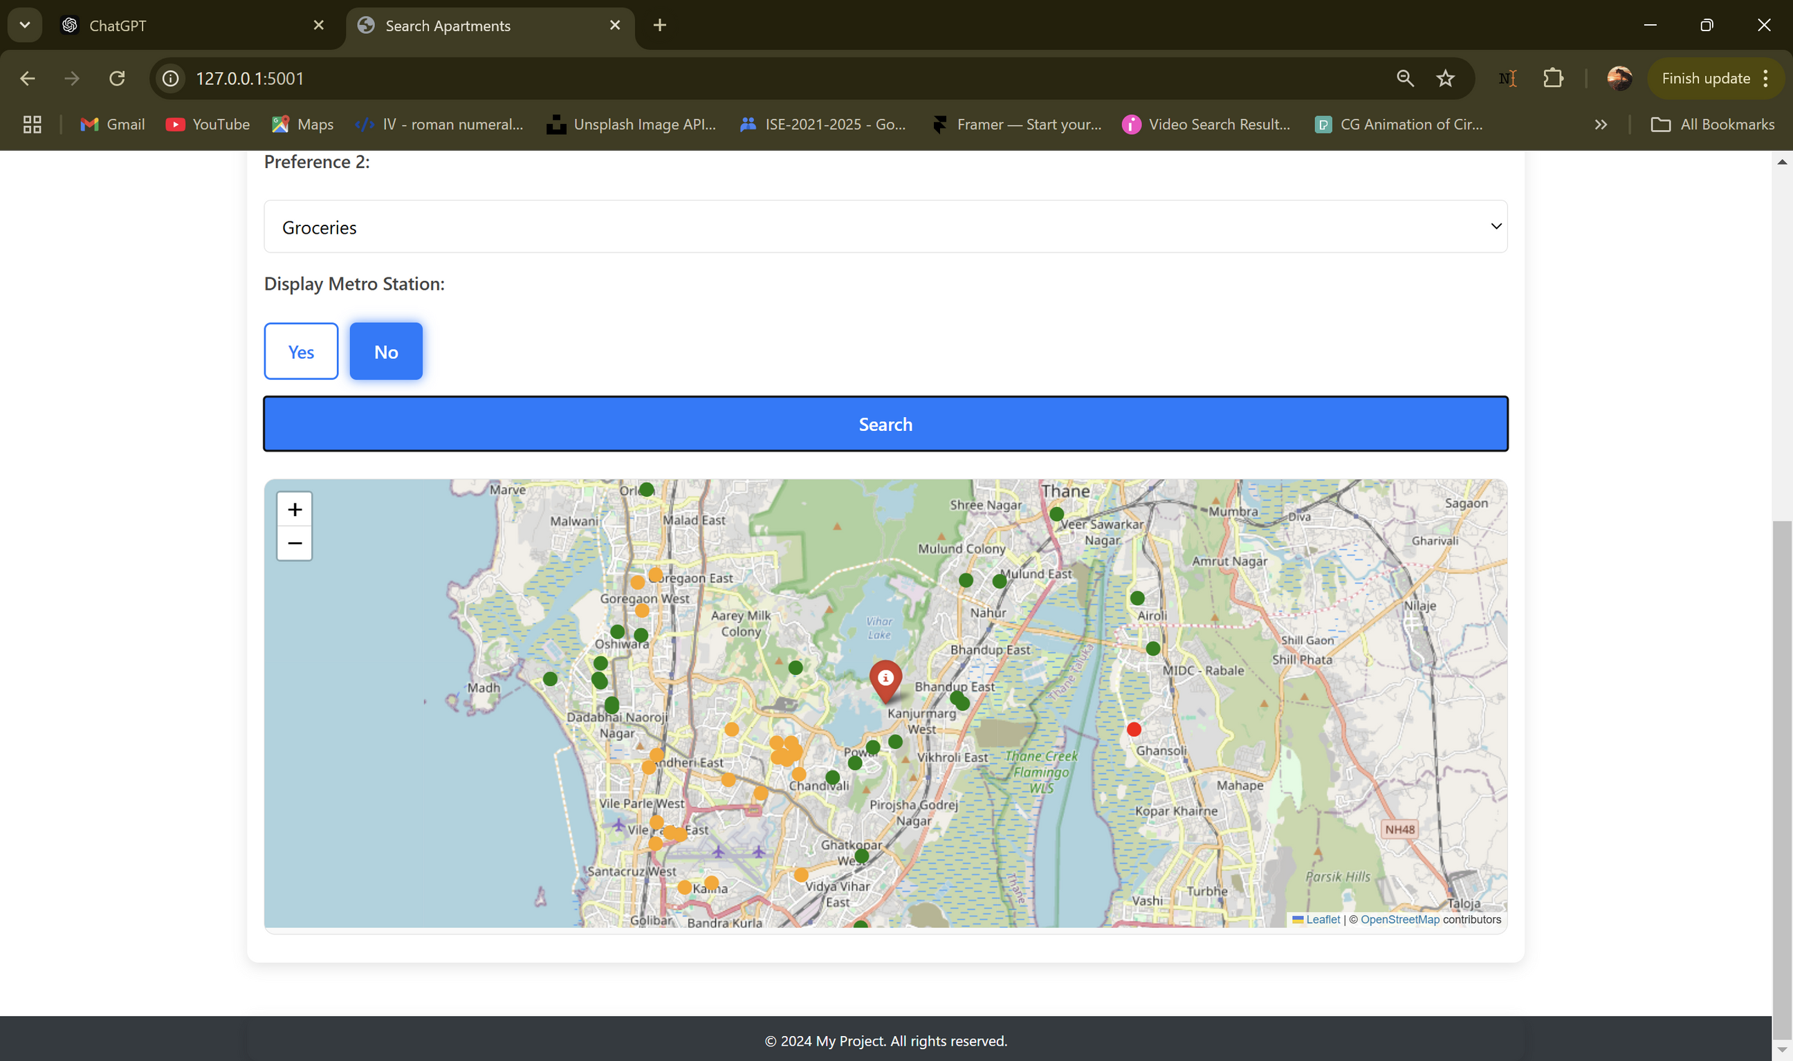
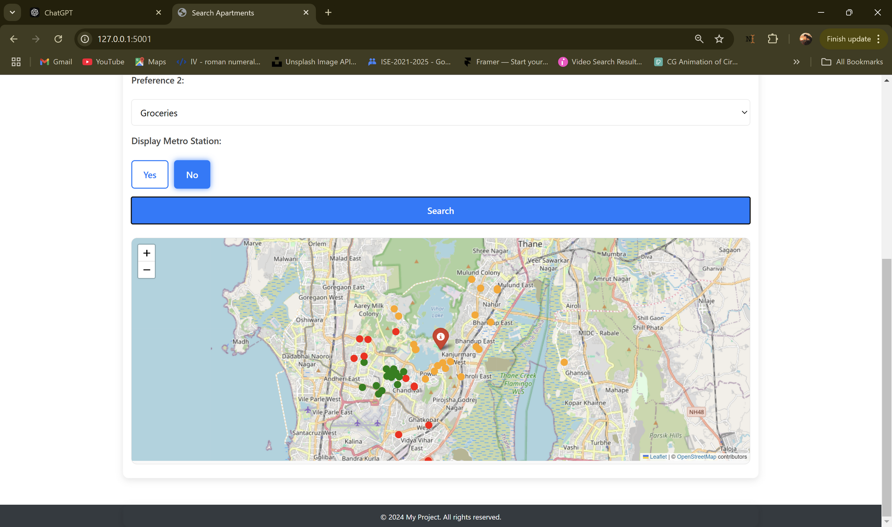
Implementation Continued
Outer Radius = 18km
Outer Radius = 6km

Slide 21
Implementation Continued

Slide 22
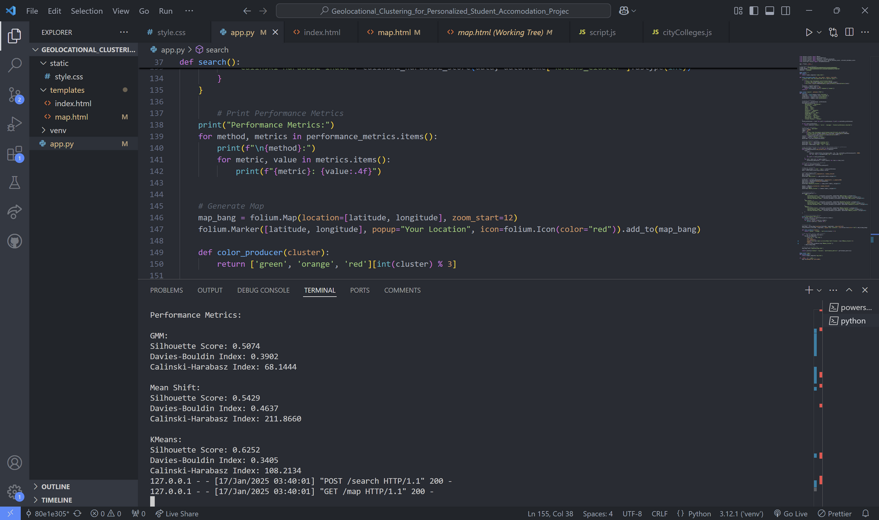
Analysis

Slide 23
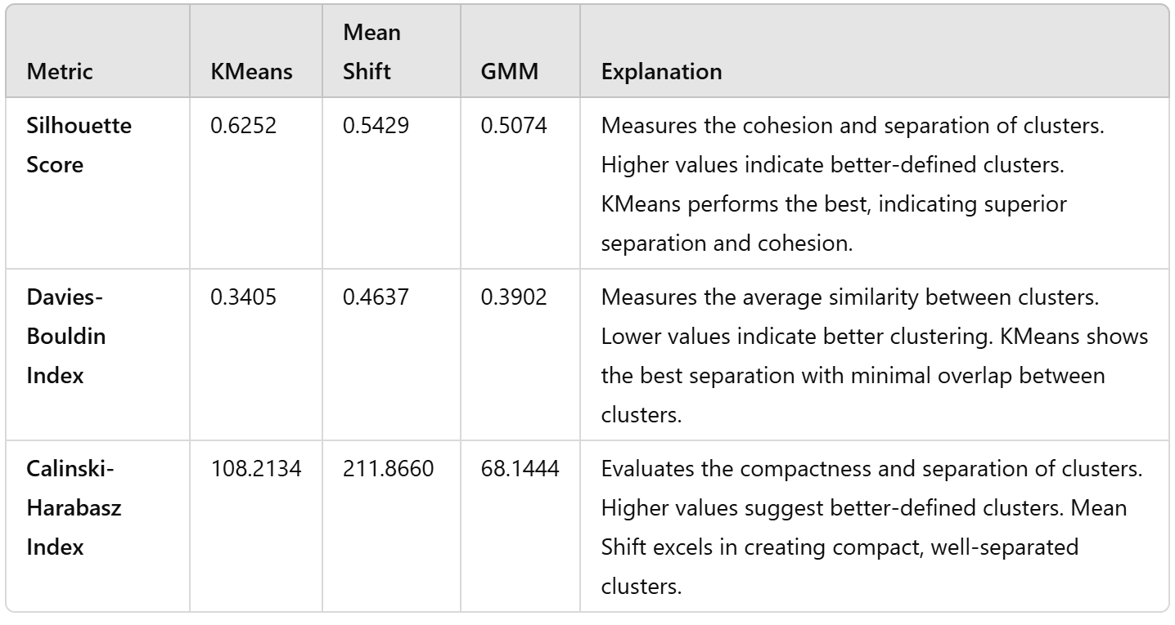
Analysis Continued

Slide 24
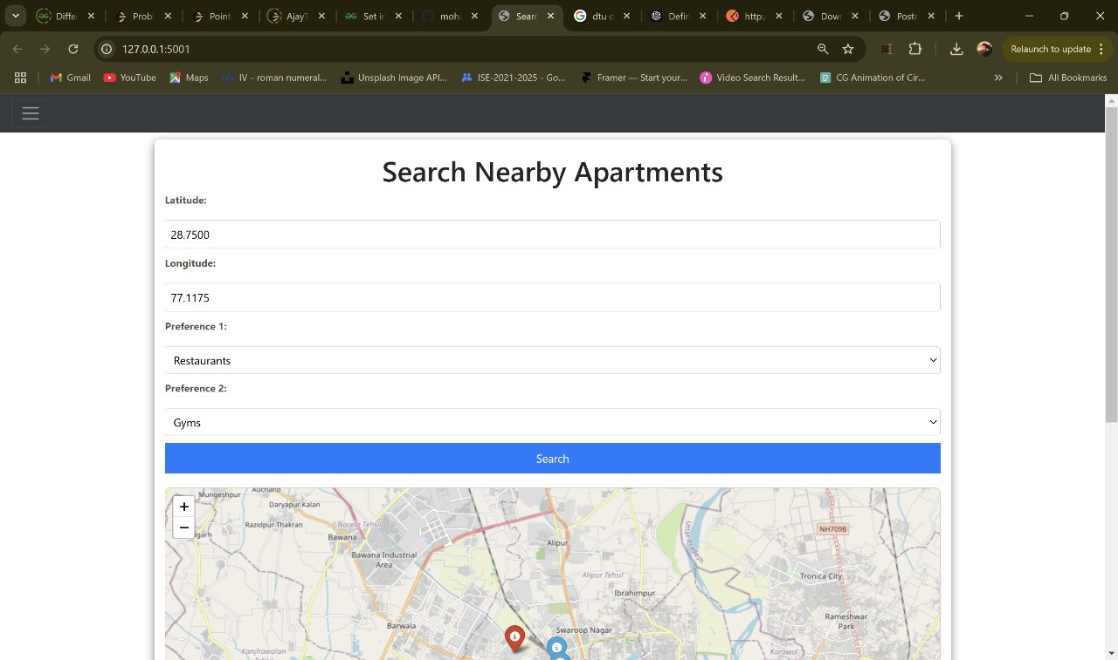
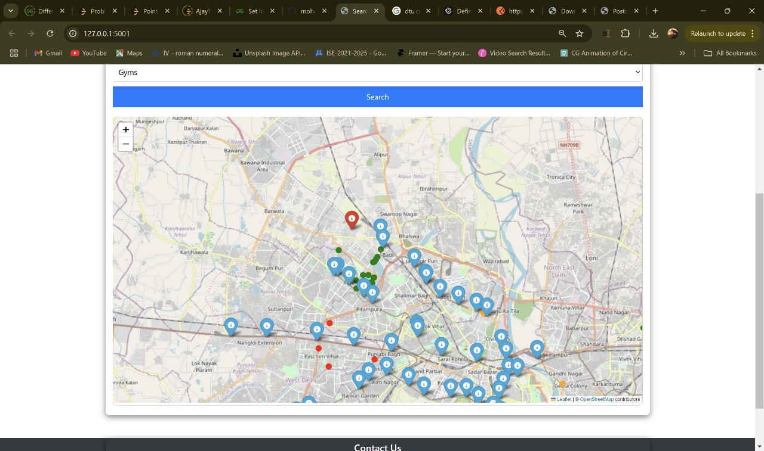
Results
Input labels:
Latitude, Longitude or City, University
Preference 1
Preference 2
Output:
Highlight the university
Display the apartments within 18km radius of the University
Display the density of the user preference(Red, Green, Yellow)

Slide 25
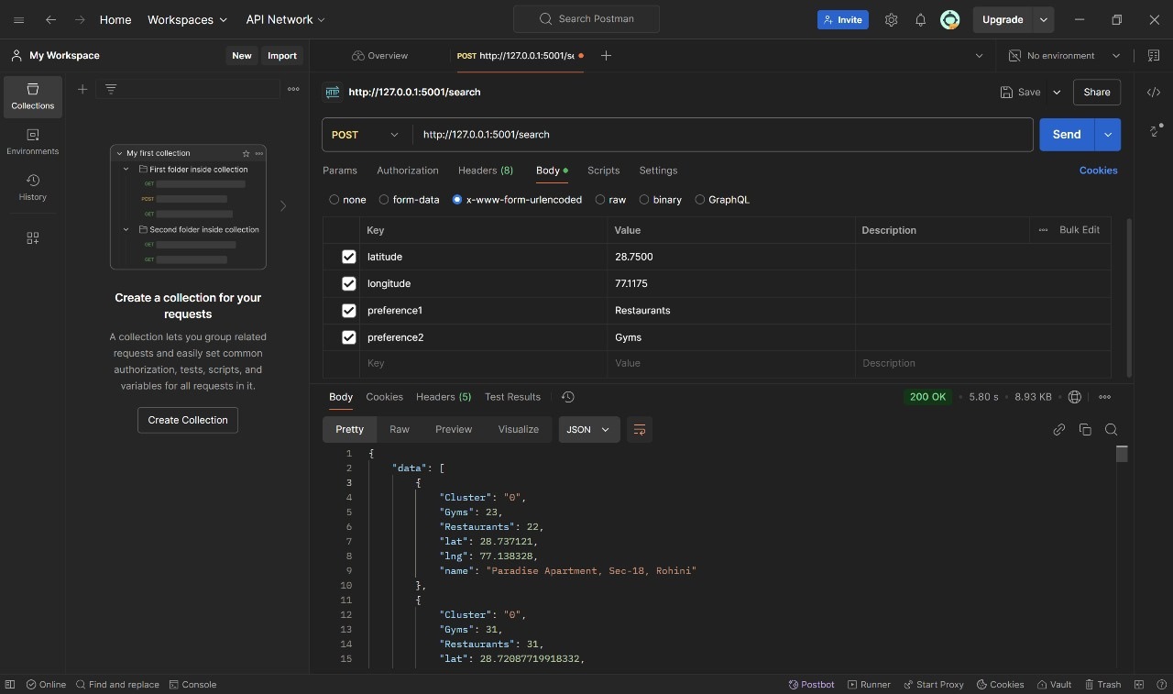
Visualization of the result using postman API

Slide 26
Conclusion
The project uses geo-data and K-Means clustering to group accommodation based on user preferences.
It simplifies finding suitable housing based on user preferences and gives intelligent suggestions.
Clustering identifies areas with varying amenities, aiding better decisions.
The approach offers a personalized and limits the time consumption of the students for accommodation searching.

Slide 27
References
[1]
Rushabh Marathe and Adarsh Jadhav.
Exploratory Analysis of Geolocational Data. International Journal of Research Publication and Reviews, Vol. 4, No. 2, pp. 728–731, February 2023.
[2]
K. Geetha, A. Srivani, S. Gunasekaran, S. Ananthi, and S. Sangeetha.
Geospatial data exploration using machine learning. In Proceedings of the Fourth International Conference on Smart Electronics and Communication: ICOSEC 2023, pages 1485–1489. IEEE, 2023.
[3]
Ylenia Casali, Nazli Yonca Aydin, and Tina Comes.
Machine learning for spatial analyses in urban areas: a scoping review. Sustainable Cities and Society, Volume 85, Article 104050. Elsevier, 2022. (Journal)
[4]
IBM. (2023). What is k-means clustering? Retrieved from IBM​
https://www.ibm.com/think/topics/k-means-clustering

Slide 28
Thank you

